Slide 1



GeoAI Amazon Basin Secret Runway Detection
Detecting hidden airstrips in the Amazon rainforest using YOLO v8
Project Details
Team & Mentorship
By Team:
Adyansh Agarwal,Ishita Dalela,
S P Suhas,Khushi Jayaprakash
College: PES University
Start Date: 07/04/2025
End Date: 02/09/2025
College Mentor:
Prof. Rajasekar M
Nokia Mentor:
Mr. Kodandaram Ranganath
Effective Months: (07/04/2025-30/04/2025) & (01/06/2025-02/09/2025)

Slide 2
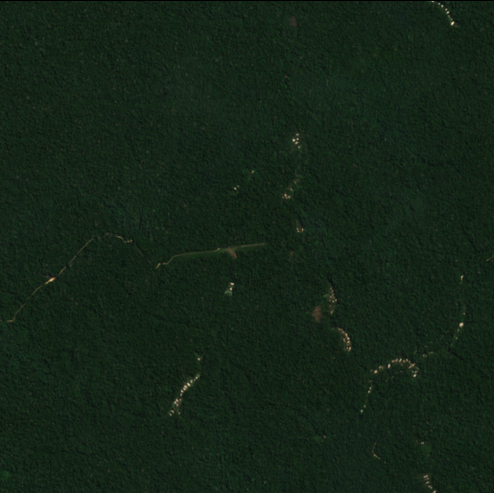
Problem Statement
Illegal drug trafficking in the Amazon basin
often use hidden runways
Difficult to detect under dense forest canopy
Detecting these airstrips can help law enforcement act quick

Slide 3
The Original Team’s Approach
Google Earth Engine data
Visual confirmation - Sentinel-2’s RGB/SWIR bands
Cross validate - Sentinel-1’s SAR bands - penetrates clouds
emits microwave signals, measures reflection (5 total)
Date-wise composite (over one day)
Cloud-free
RGB Band normalisation - 0 to ~10,000+ - clips to 0-2000 - normalizes to 0-1
above 2000 are often clouds, snow

Slide 4
The Original Team’s Approach
U-Net with ResNet50 encoder, pre-trained weights from ImageNet
Dice loss, Adam optimiser
Workflow:
Download, crop & visualize Sentinel data.
Clean GeoTIFFs and remove NaN borders.
Generate runway masks from shapefiles.
Train the model
Run inference on the model
Post-process predictions — remove roads via OSM, PCA
Reference: https://github.com/liangchow/zindi-amazon-secret-runway

Slide 5
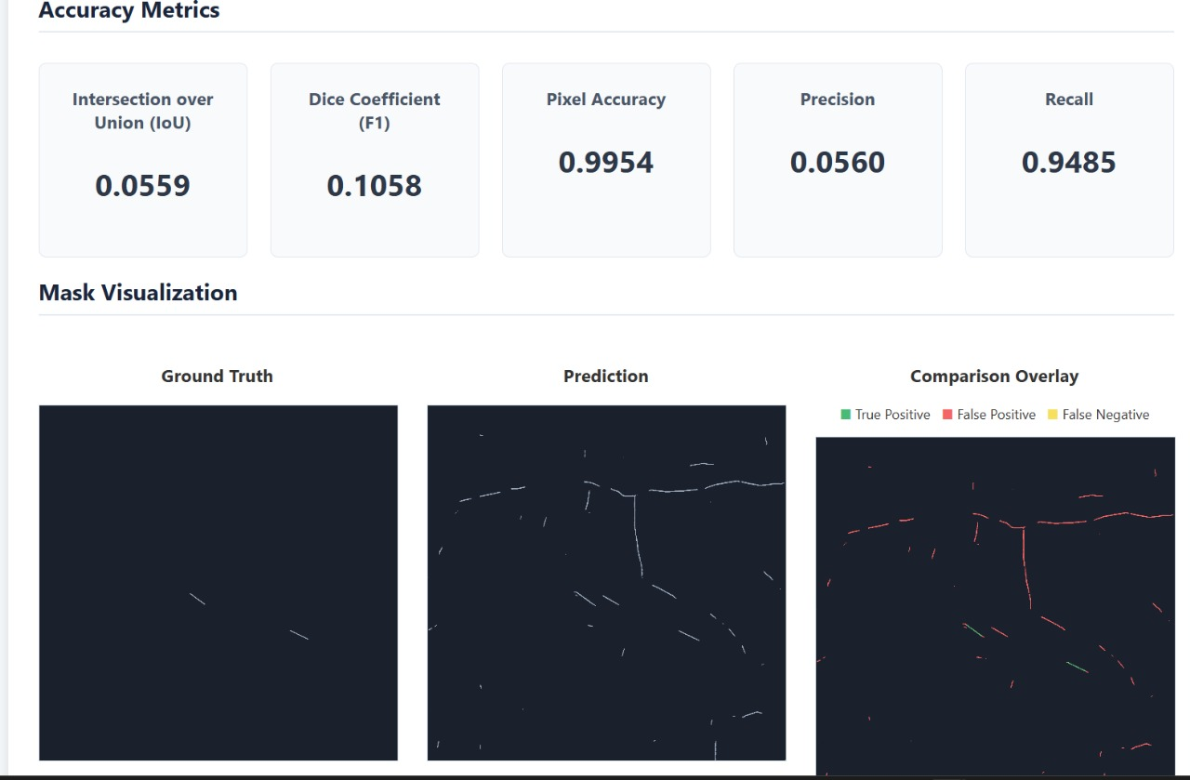
Original Approach - Suggestions
Test Loss functions
Loss - geometric runway shape
Training dataset size - 154 imgs- 1262
Try DeepLabV3+
Addition of more bands

Slide 6
Original Approach - Additional issues
Tiling issues - overlap added
VV, VH noise - preprocessing to remove
VV,VH terrain - DEM - RGB
Road overlap
Osm - computationally heavy - mask overlay - bounding box
Downloading whole area
Poor accuracy - high false negatives - localisation pivot

Slide 8
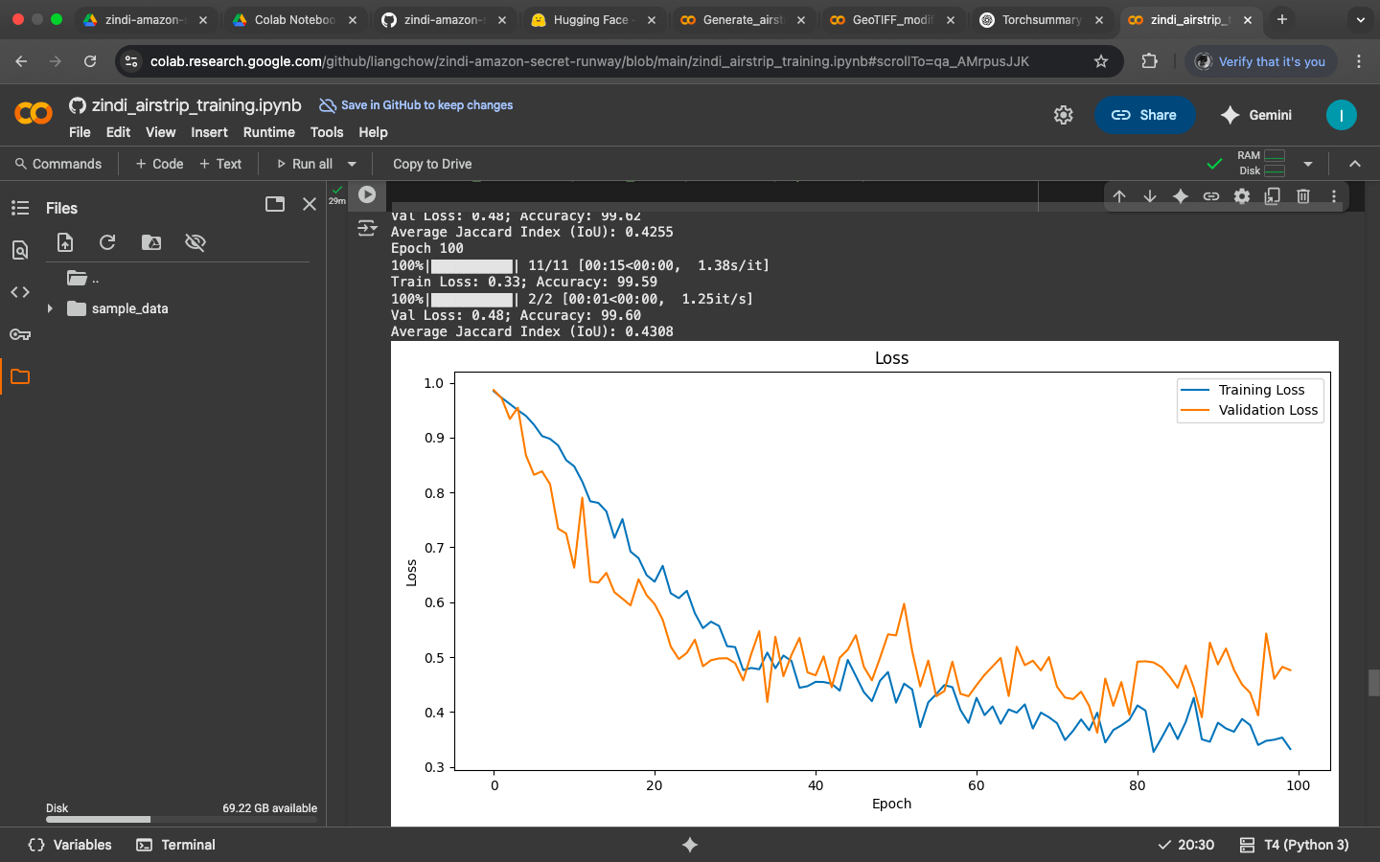
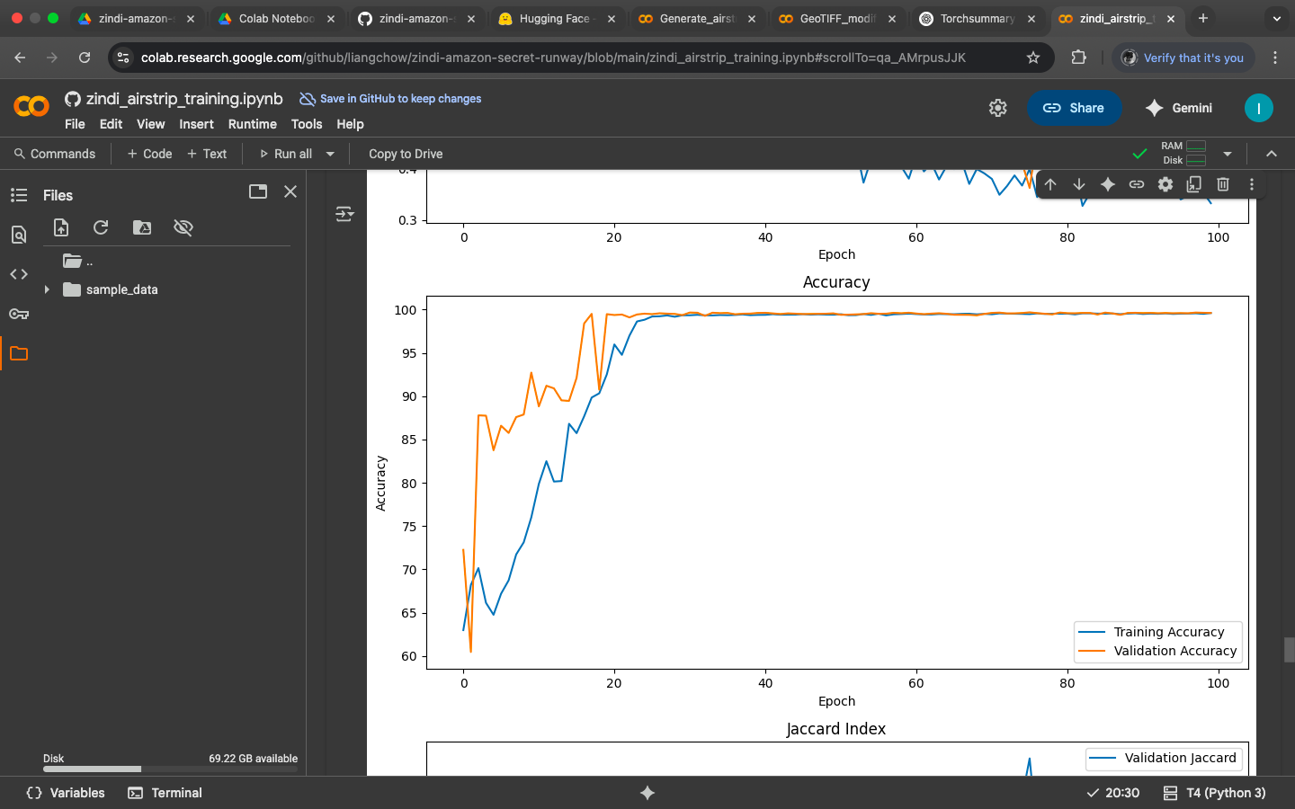
Dice Loss

Slide 9
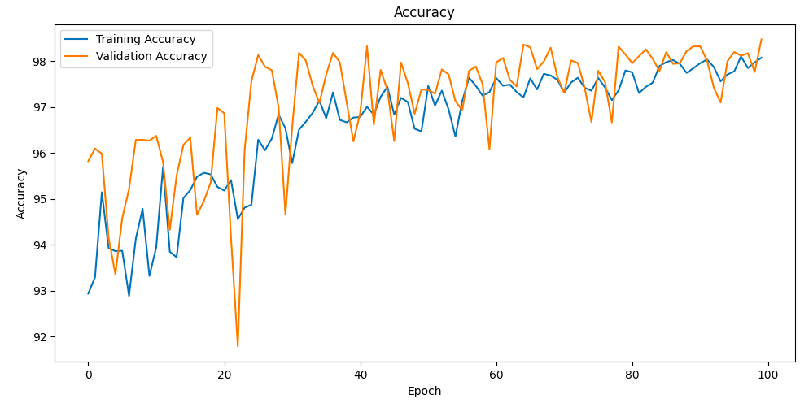
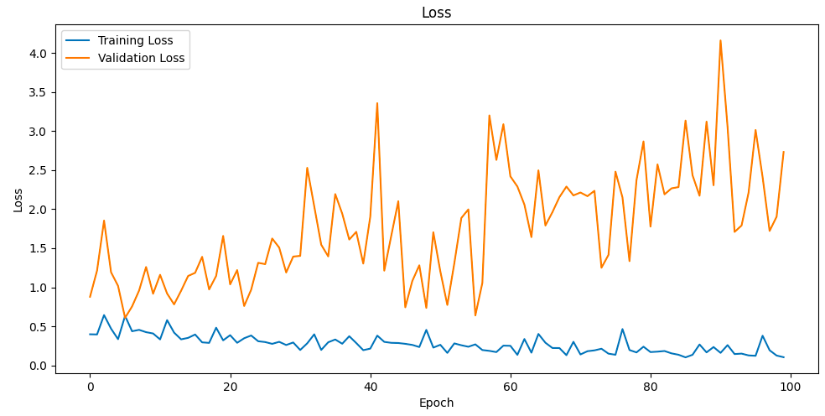
BCE Loss

Slide 10
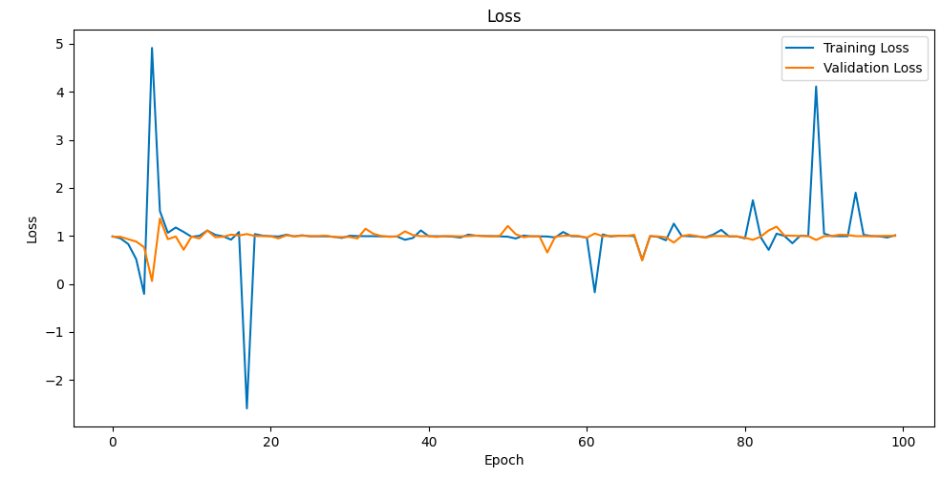
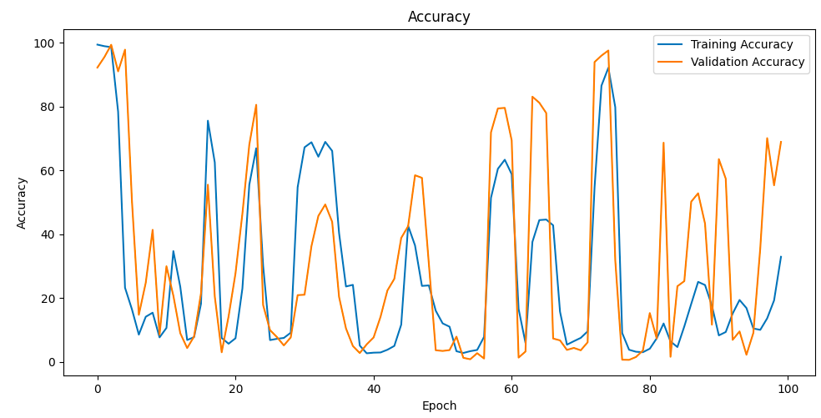
Jaccard Loss

Slide 11
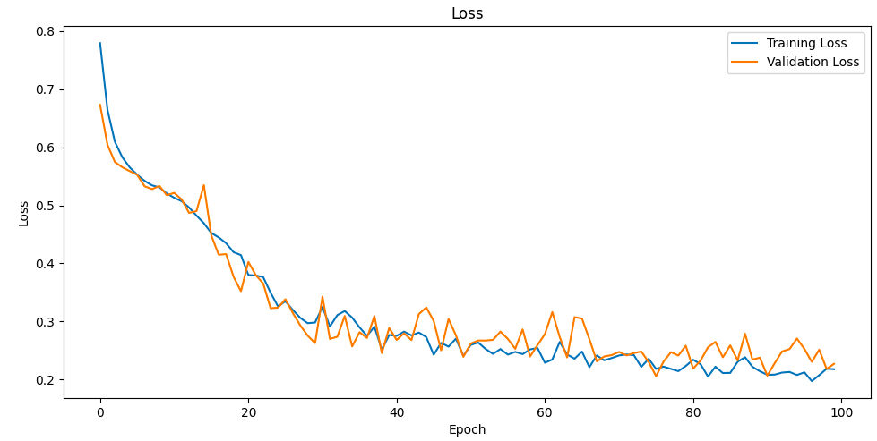
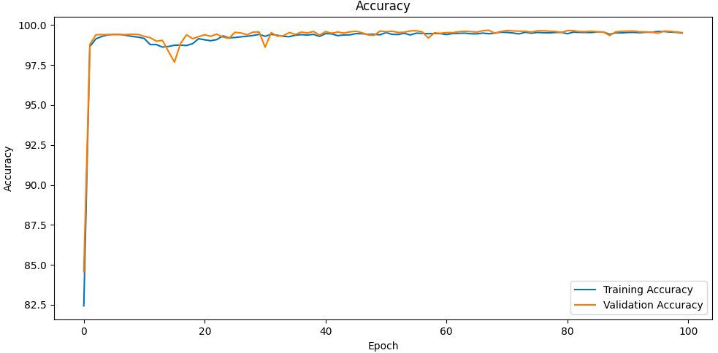
BCE-Dice Loss

Slide 12
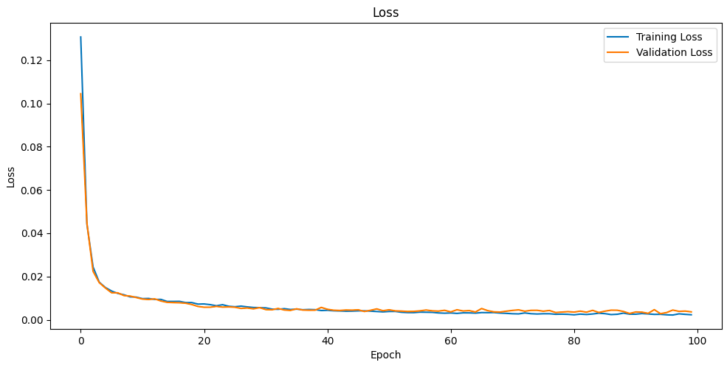
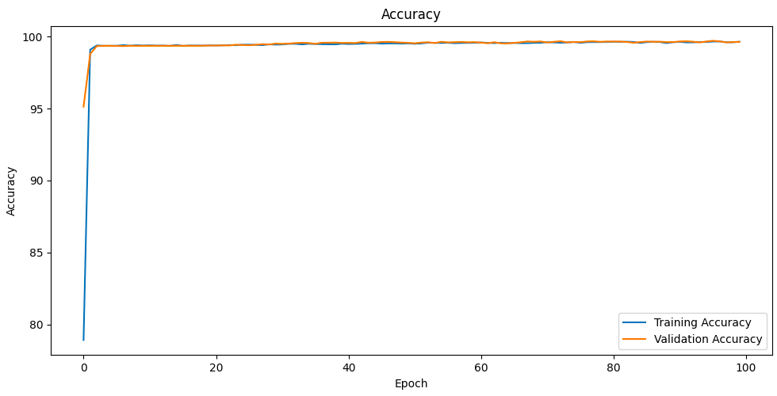
Focal Loss

Slide 13
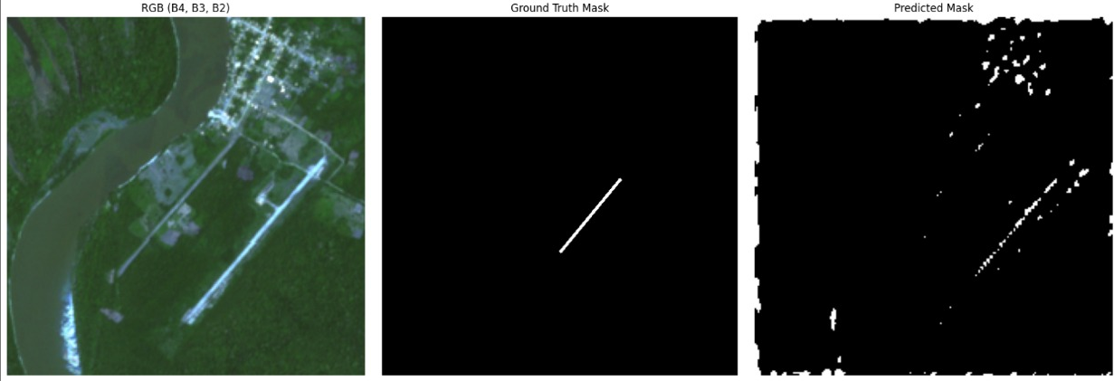
Using Focal Loss + DeepLabV3+
Lack of localisation - segmentation
Predictions with ground truth masks
False detections in non-runway areas.

Slide 14
Our Solution
Abstract
We developed a YOLOv8-based system to detect clandestine airstrips in the Amazon Basin, enabling real-time, large-scale monitoring of illegal activities. Unlike older segmentation models, our approach delivers precise bounding boxes, integrates DEM filtering to remove unsuitable terrain, and leverages OSM overlays to cut false positives from roads. Combined with a larger curated dataset and efficient tiling, the pipeline offers accurate, scalable, and actionable intelligence for enforcement and conservation.
Novelty
YOLOv8 replaces patch CNN
Bounding boxes > segmentation masks
DEM slope filter for terrain viability
OSM overlay for false-positive reduction
Larger, re-annotated dataset

Slide 15
Our Initial Approaches
YOLOv8 : Precise Bounding Boxes Direct bounding box predictions replace noisy segmentation masks. Faster, cleaner outputs enable real-time monitoring, easier human verification, and higher localization accuracy across vast regions.
Data Elevation Model (DEM) Preprocessor : Terrain filtering
Copernicus DEM data provides terrain analysis, removes tiles with infeasible terrain (>2° slope). This reduces false positives, cuts search space, and ensures detections focus only on viable runway sites.
Open Street Map (OSM) Overlay : Context-Aware Validation Bounding boxes are cross-checked against OSM data for roads and man-made structures. Suspect overlaps are flagged(marked with yellow boxes), reducing road-like false positives and introducing transparency for rapid human validation.
Tiling + Stitching : Allows quick search on large AOIs AOIs are divided into overlapping 512×512 tiles for inference, then stitched back with detections.

Slide 16
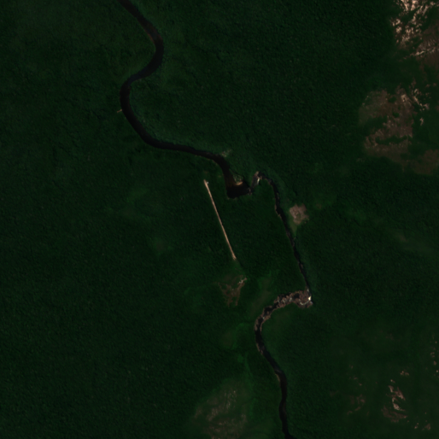

Development - Enhancing the Dataset
Used the NYT dataset (1,262 locations) - richer than 154-image baseline
Copernicus Sentinel-1 & 2 imagery -radar + optical mix, penetrates cloud cover
Extracted 9 spectral bands from Google Earth Engine using data from copernicus.eu dataspace - full spectrum for validation
Manual binary mask annotation - ensures label accuracy
Converted to YOLO bounding boxes - training-ready format

Slide 17
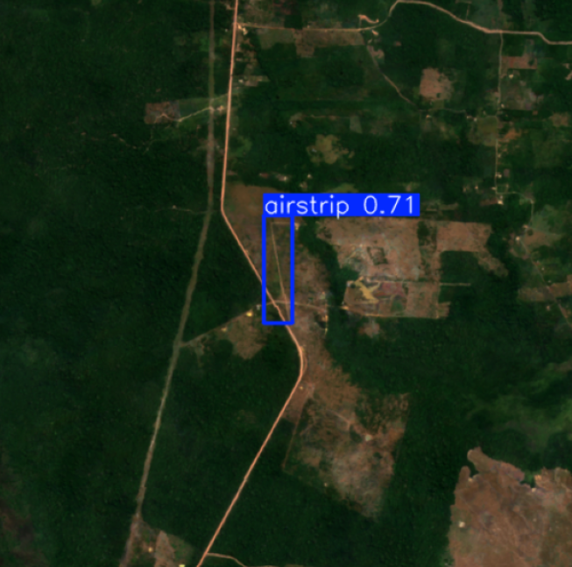
Development - YOLO Training
Input: RGB channels only - other bands added noise, reduced clarity
Model: YOLOv8s - 11.2M parameters
Resolution: 512×512 px @10m
Dataset: 708 training 177 validation images, rest kept aside for testing
Trained for 150 epochs - stable learning, high confidence

Slide 18
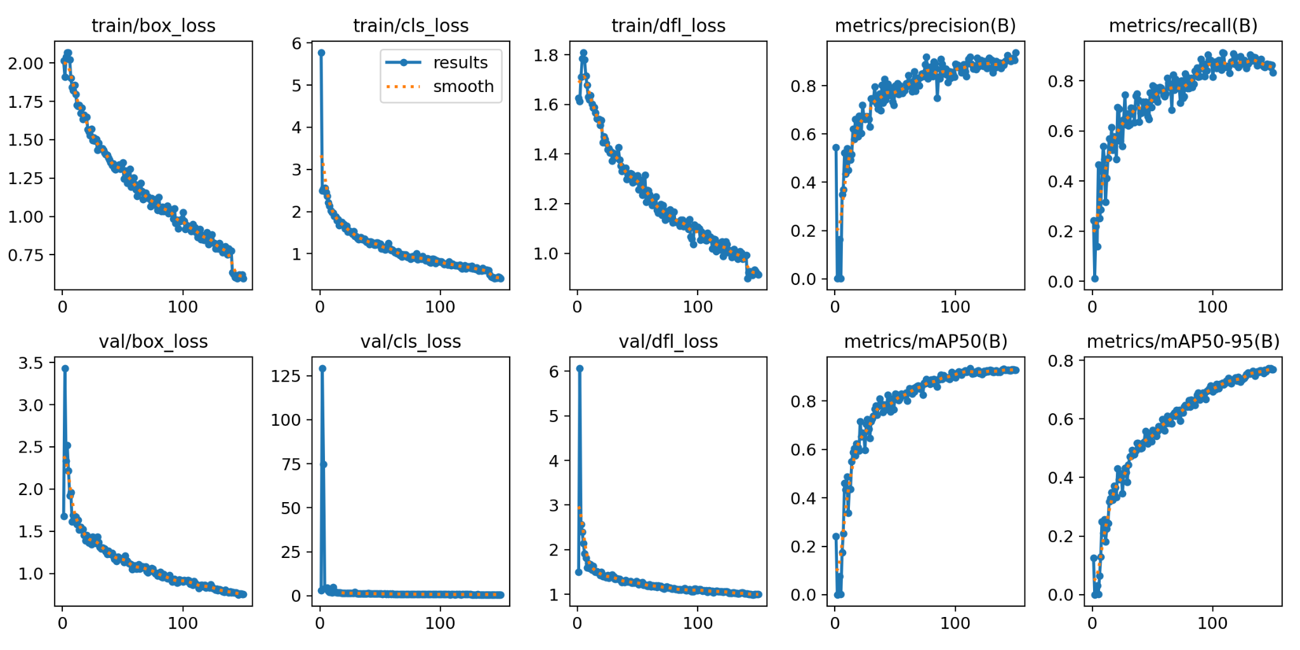
Results & Metrics
Results after Training

Slide 19
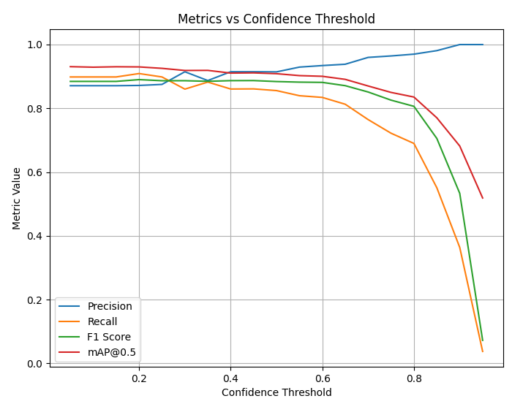
Results & Metrics
 | Train Initial | Train Final | Validation Initial | Validation Final
Box loss | 2.01354 | 0.59573 | 1.67715 | 0.74876
Class loss | 5.77662 | 0.41188 | 2.95033 | 0.62287
DFL loss | 1.62607 | 0.89890 | 1.50289 | 0.99481
Confidence threshold data from metric maxing - final threshold used 40%

Slide 20
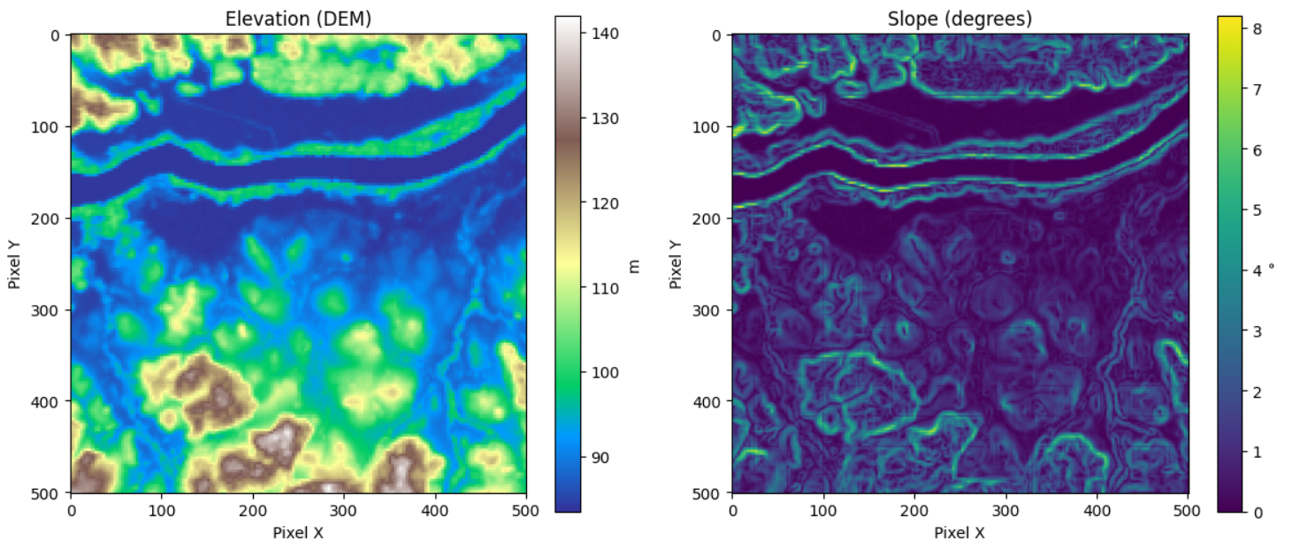
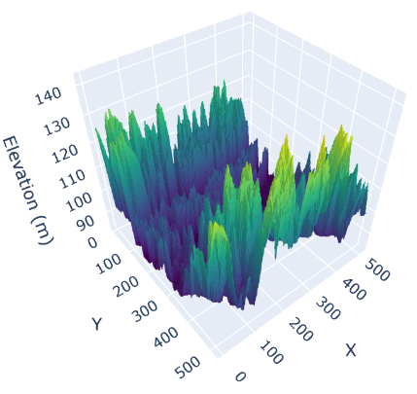
Development - DEM Preprocessor
Source: Copernicus DEM (30m) - high-quality elevation data
Threshold: ≥10% slope <2° - feasible runway terrain only
Filters steep, unusable regions - eliminates false sites early
Narrows search space - model focuses on realistic candidates

Slide 21
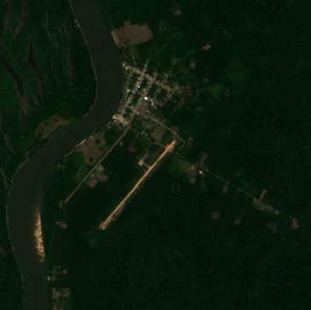
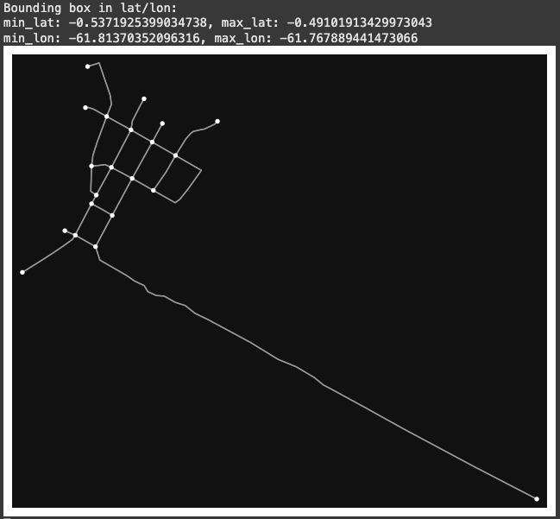
Development - OSM overlay
Source: OpenStreetMap data accessed via Overpass API
Removes road-like false detections -roads, man-made structures, highways.
Bounding boxes with road overlap are flagged and marked in yellow - ensure expert validation

Slide 22
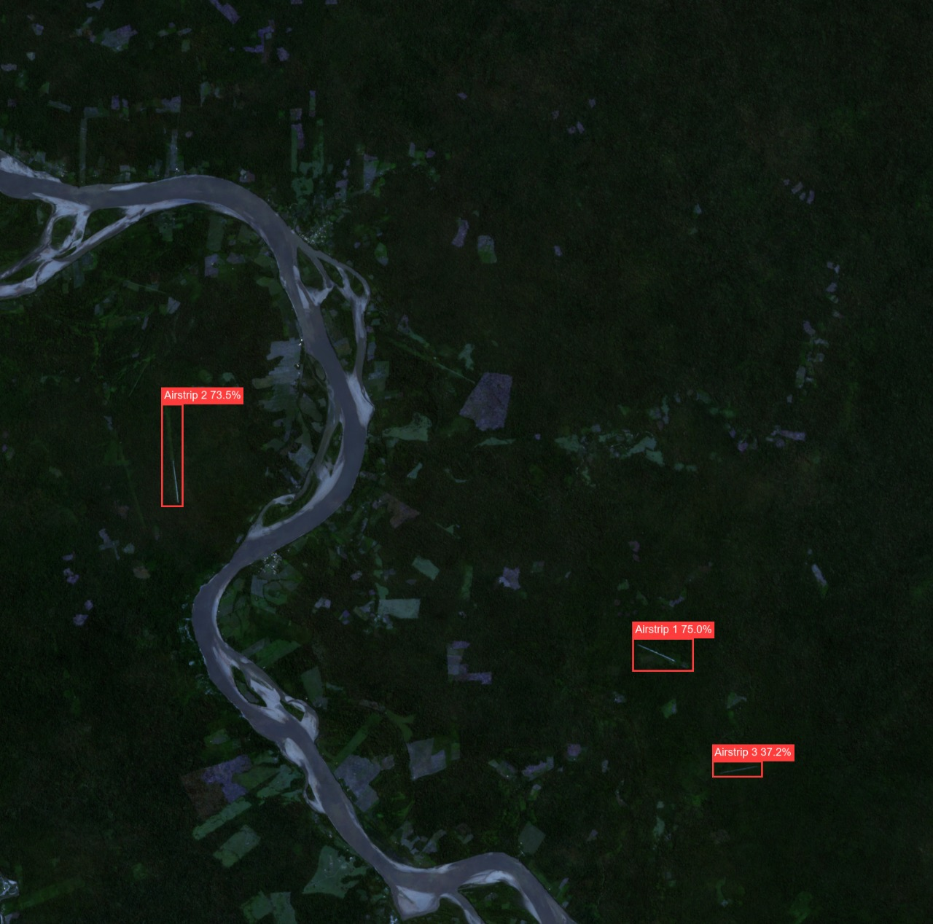
Development - Tiling & AOI Processing
AOIs: 50×50 km regions - large operational zones
Split into 5.12×5.12 km tiles - 512×512 px each
256 px overlap - avoids edge artifacts, missed detections
Each tile - preprocessed, run through YOLO, post processed
All tiles stitched back - detections mapped to full AOI

Slide 23
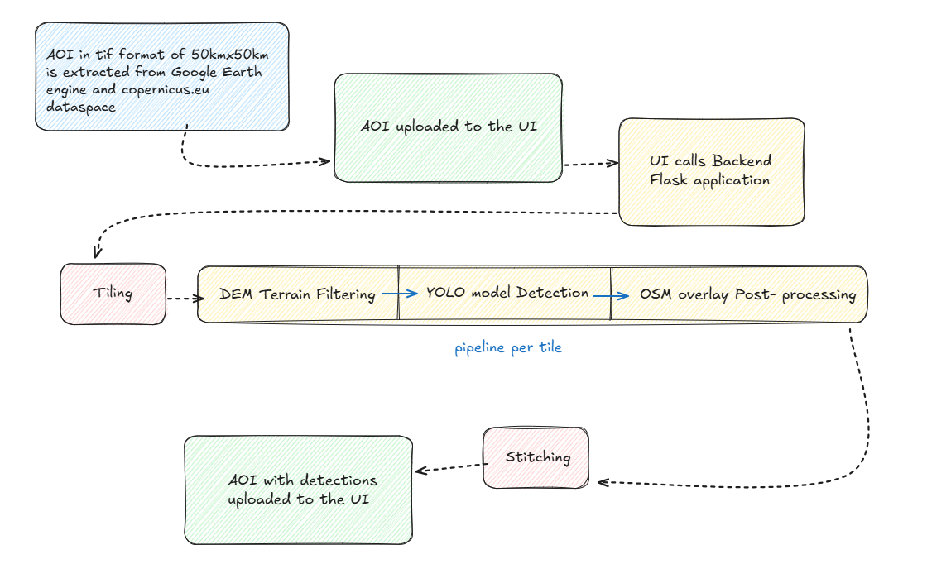
Pipeline

Slide 24
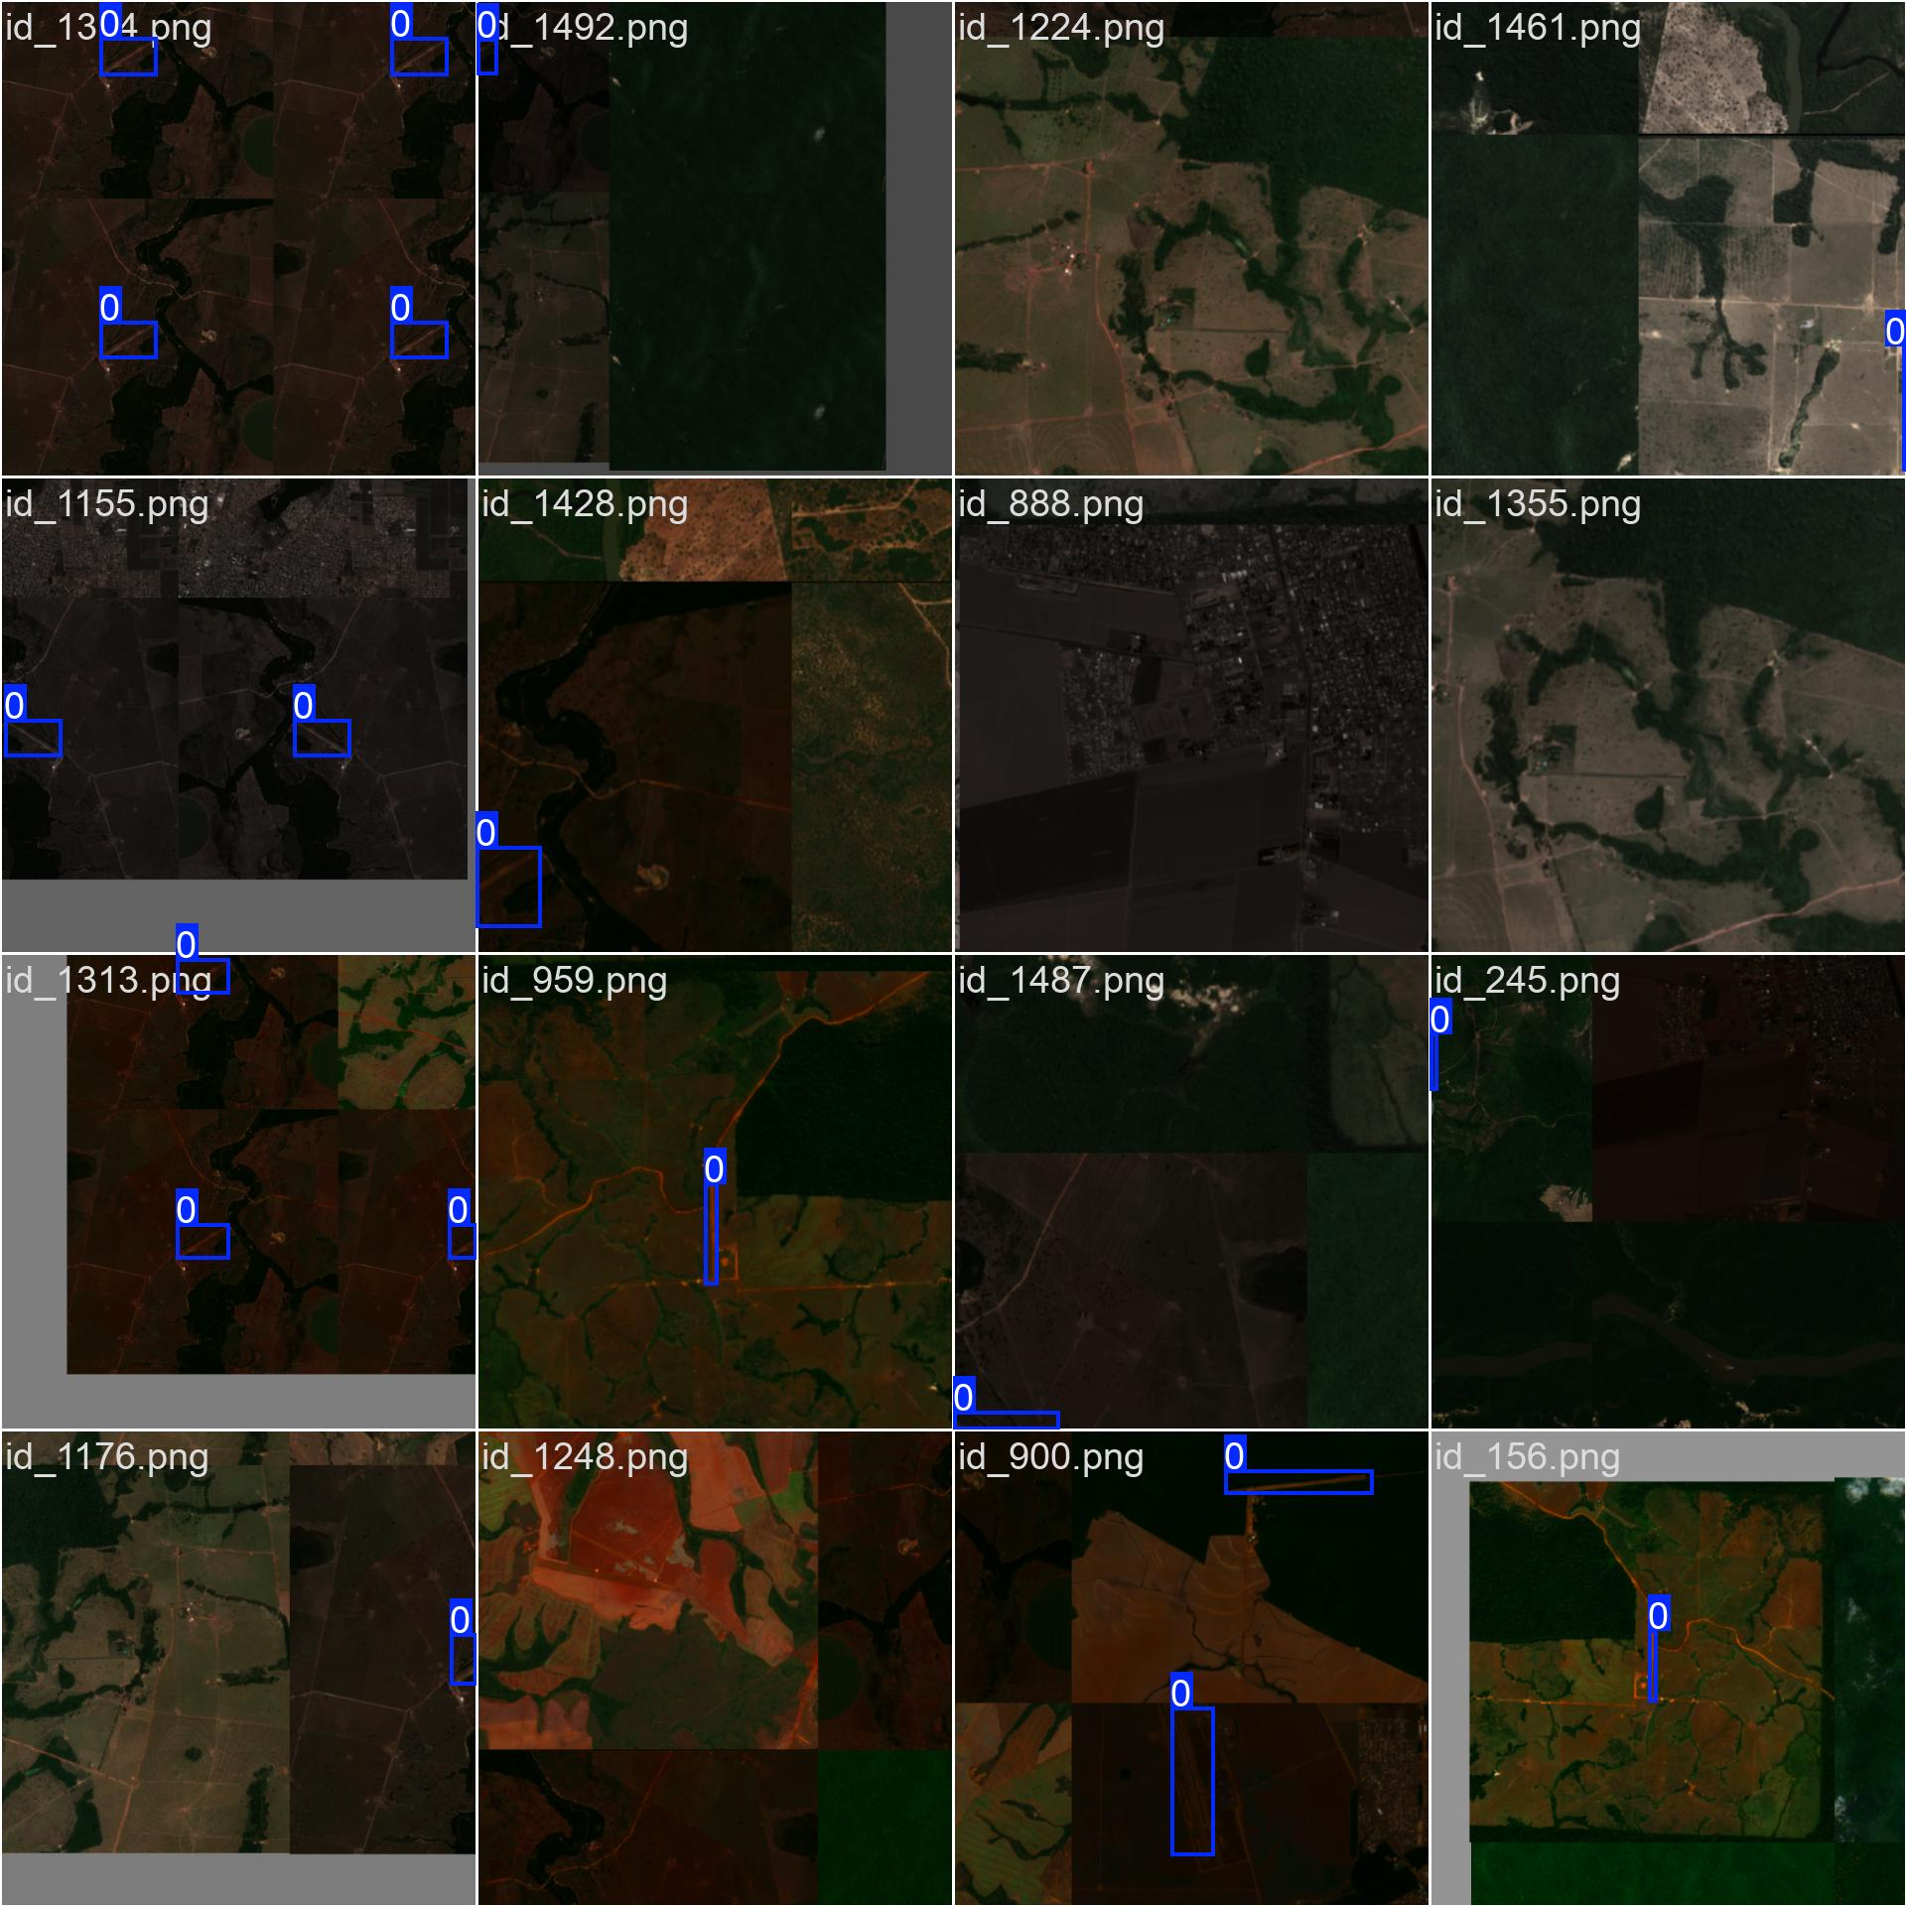
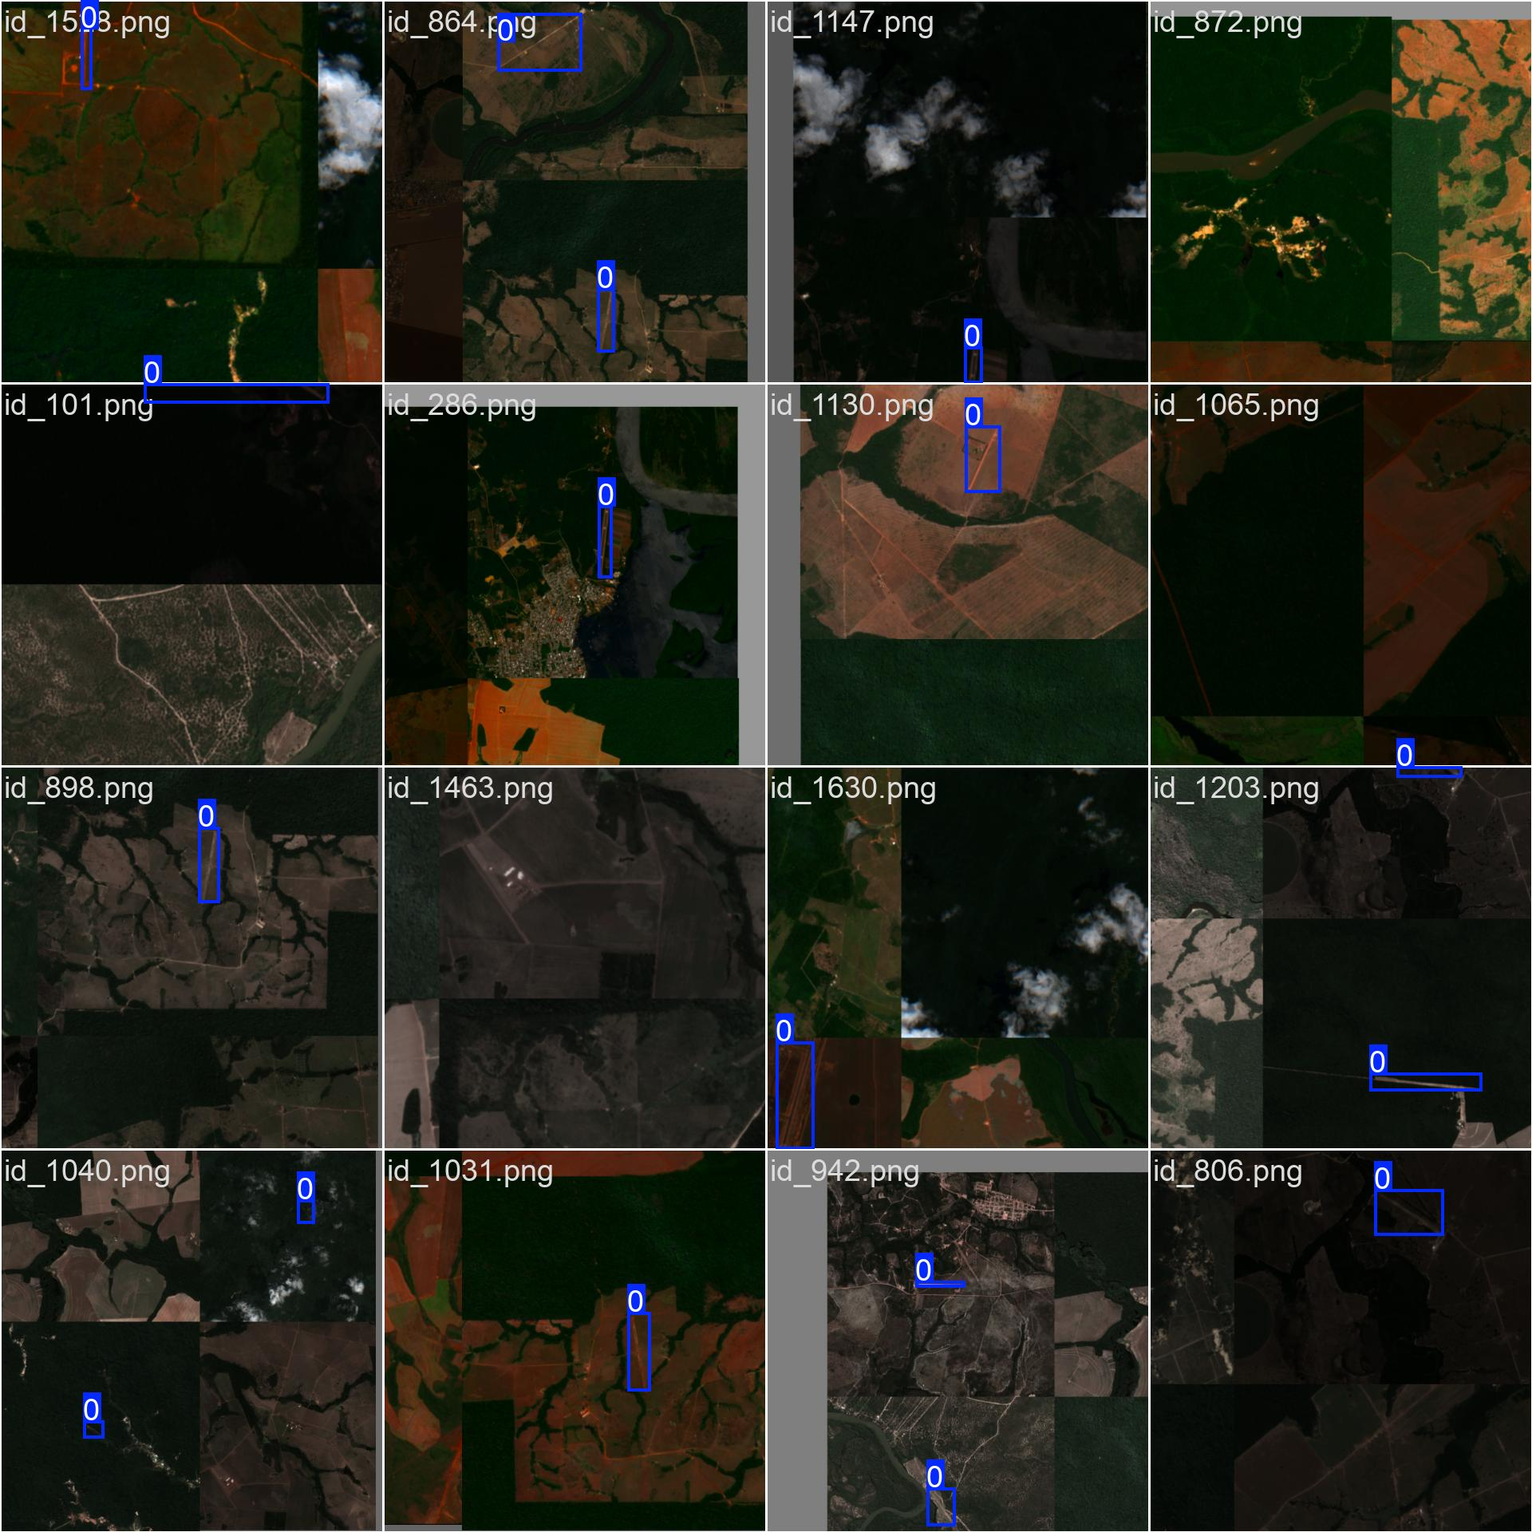
Augmentation Batches
Augmented training batches

Slide 25
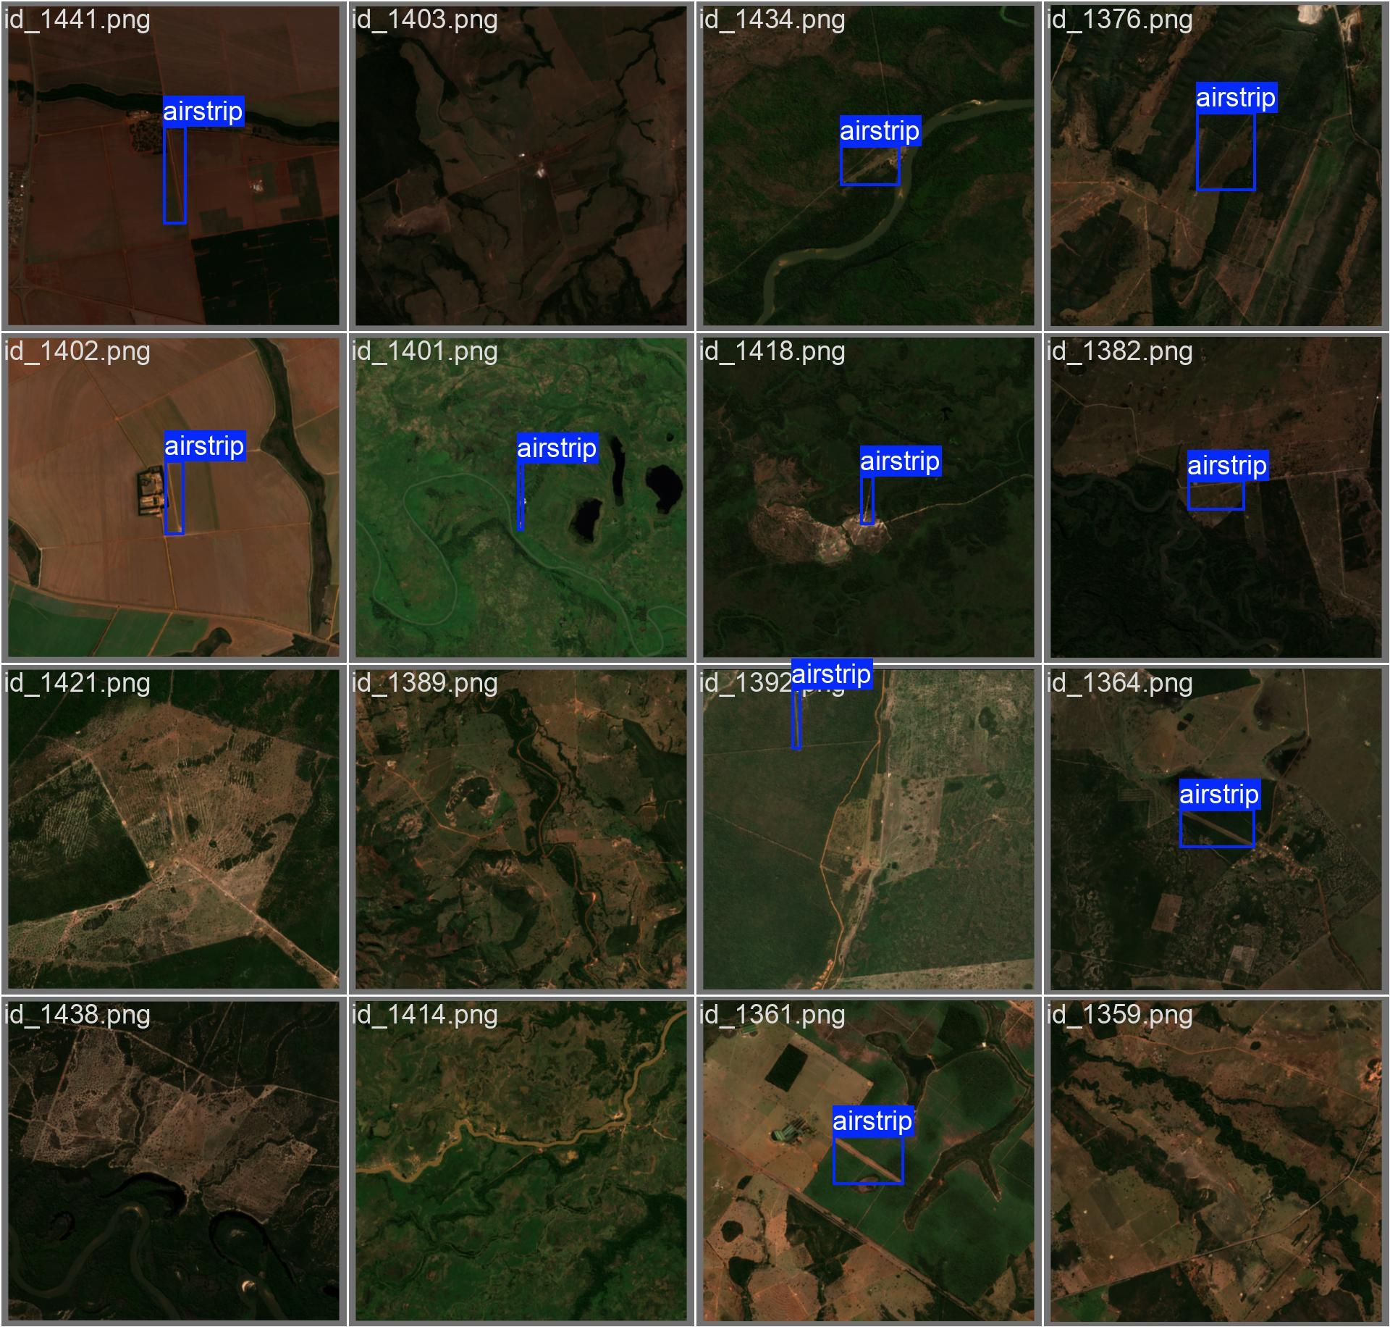
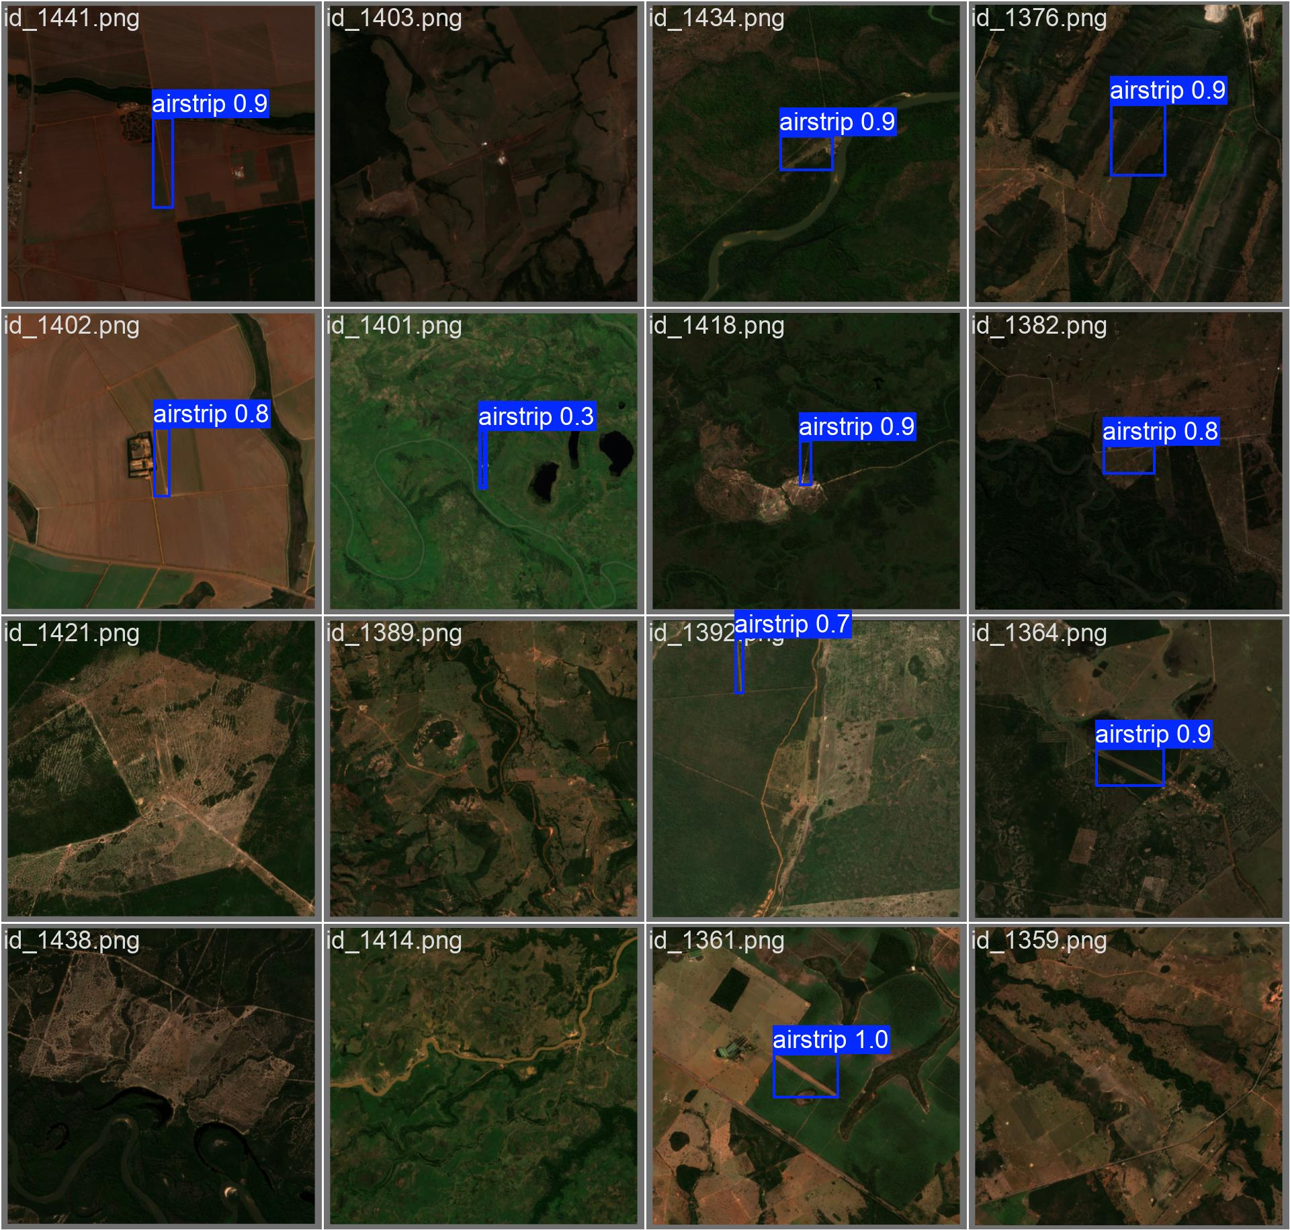
Validation
Validation batch with the bounding boxes Predictions from yolo model

Slide 26
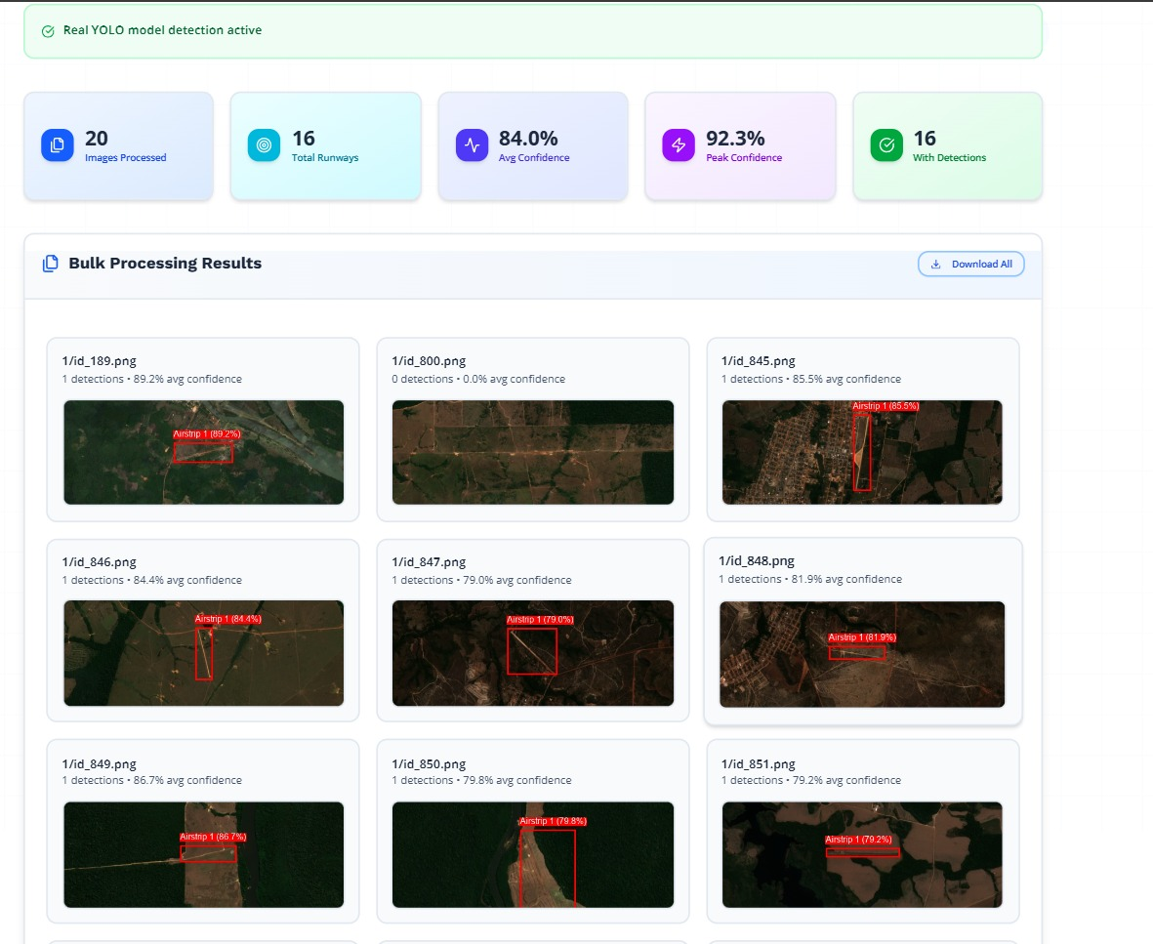
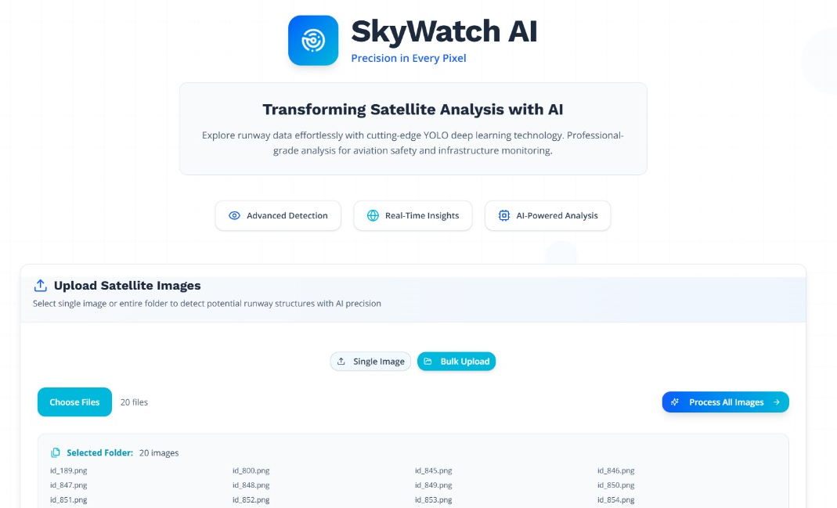
Working Demo

Slide 27
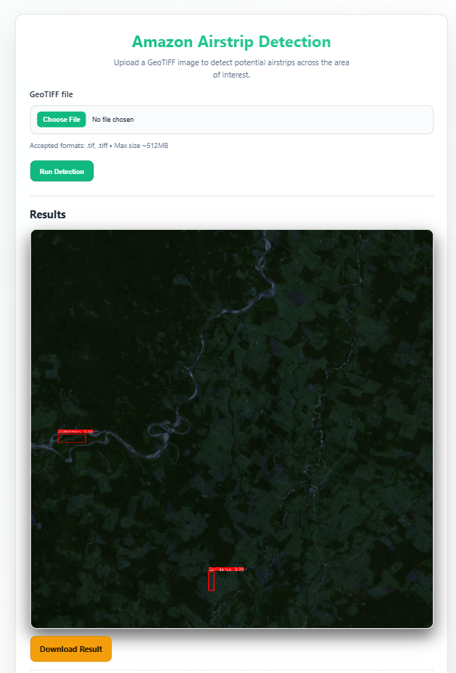
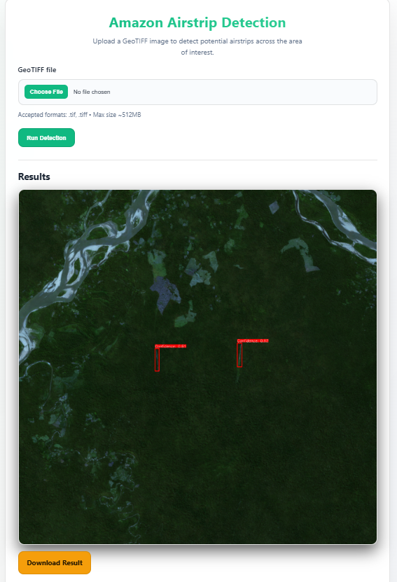
Working Demo

Slide 28
Future Scope
Extend to other regions - terrain types.
Build real-time monitoring dashboard using satellite feeds.
Incorporate thermal or hyperspectral data to detect recent runway activity.
Automated alerts to environmental authorities when new runways are detected.

Slide 29
Q n A

Slide 30
Thank You

